Slide 1
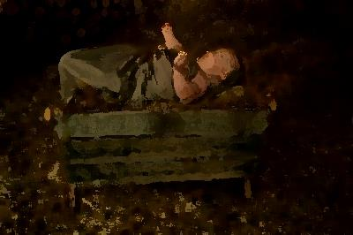
SAVIOUR BABY

Slide 2
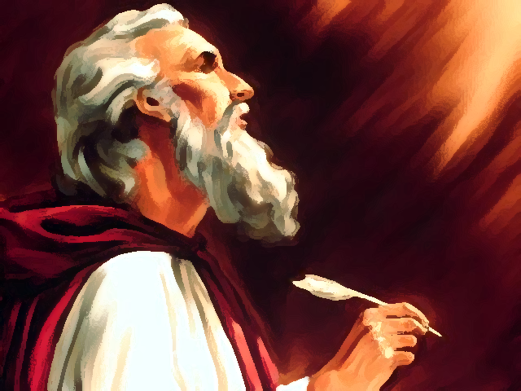
In ages past the prophets told
Of things to come, of things of God.
They spoke to men of hope and love.
They told how God would one day send
A Saviour, Prophet, Priest and King,
God’s only Son sent from above.

Slide 3
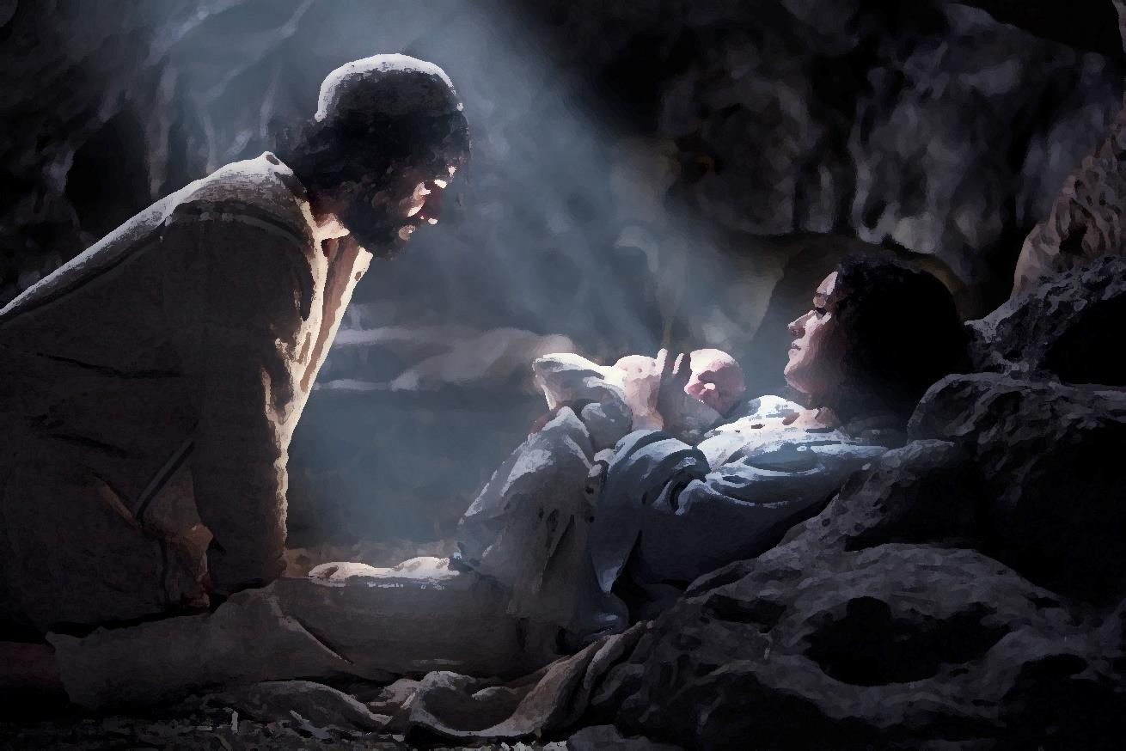
Years beyond in Bethlehem,
A village hardly known to men,
A child was born, a humble birth.
A dirty stable, winter night,
His loving mother held him tight.
This was the Saviour of the Earth.

Slide 4
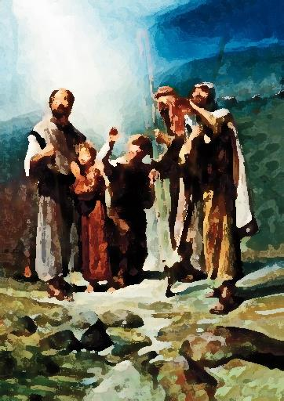
A star shone brightly in the night.
Hillside shepherds stood in fright
As angels sang of joyful things.
The shepherds, longing, left their sheep
And rushed into the town to seek
The Saviour baby, King of Kings.

Slide 5
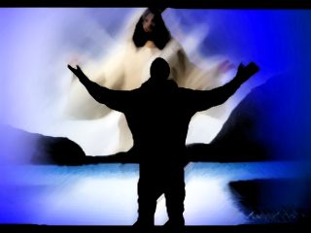
Jesus grew into a man,
The climax of the mighty plan.
He healed, He preached he
showed the way.
He suffered for all the sins of man.
He died and then He rose again
and drove the fear of death away.

Slide 6
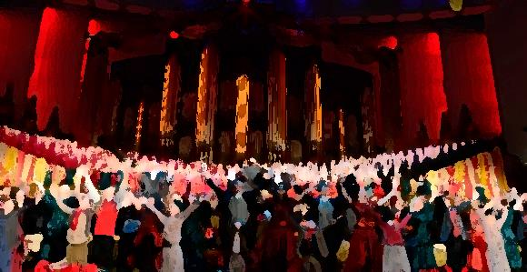
Christmas has again come ‘round
And all about you hear the sound
Of celebrating. Life is good.
Let’s sing with joy
and thanks and praise.
Jesus gave us life again,
this baby born,
This Son of God.

